Slide 1
Effects of elevated soil temperature, irrigation, and residue application on soil microbial community structure, soil respiration, and cotton physiology in the semi-arid region.
Pawan Devkota
MS Biology
(Van-Gestel Lab)

Slide 2
Introduction
Climate change

Slide 3
Introduction
Global temperature in 2011-2020 was 1.09 ºC higher than 1850-1900.
Projections:
low emission: 1 ºC to 1.8 ºC
Medium emission: 2.1 ºC to 3.5 ºC
High emission: 3.3 ºC to 5.7 ºC (IPCC 2021)
Source: IPCC

Slide 4
(Bardgett et al., 2008)
Notes:
Direct and indirect effects of climate change on soil microbial communities and feedback to global warming through carbon dioxide production. Direct effects is through influence on soil microbes and CO2 gas production, whereas indirect effects result from climate-driven changes in plant productivity and vegetation structure which alter soil the supply of carbon to soil and the structure and activity of microbial communities involved in decomposition processes and carbon release from soil.

Slide 5
Introduction
Microbes are usually adapted to prevalent temperature conditions. When the temperature changes, there will be a shift in the microbial community structure.
Owing difference in physiology and ecological adaptation, bacteria and fungi respond differently to increased temperature.
Some groups of microbes (ascomycetes, mycorrhizal fungi, actinobacteria) are more adaptive to increased temperature while some groups (thelephroid fungus, acidiobacteria) are sensitive. (Alison et al.,2008; Rui et al., 2015)
Warming also accelerate microbial decomposition, thus more C released to the atmosphere.

Slide 6
Introduction
Moreover, microbial response to climate warming is significantly altered by soil microbial habitat.
Soil physio-chemical characteristics such as soil pH, salinity, soil moisture, soil structure determines abundance and types of microorganisms present in soil.
In addition, crop cultivation practices like tillage, crop residue, cover crops etc. also influences the soil microorganisms.
Notes:
So, predicting how soil microorganisms respond to warming can be challenging.

Slide 7
Introduction
Drought is another important consequences of climate change, especially in arid and semi arid regions.
Increasing drought causes decline in microbial functions and impairs ecosystem sustainability.
Dry soil decreases proportion of water filled pore spaces (WFPS) that affects growth and movement soil anaerobic microbes.

Slide 8
Introduction
The soil microbial response will be different when more than one climate change factors interact. Warming mainly affects the community structure, while precipitation affects the alpha diversity, and the interaction between warming and precipitation affects both diversity and structure (Olivera et al., 2019).
In normal precipitation years, the warming treatment significantly increased microbial population size by 40–150%, however, during drought - 50–80% reduction in the microbial population size when compared with the control (Sheik et al., 2011)
Crop residue conserve soil moisture and regulates soil temperature , thus helps to mitigate effects of climate change to some extent.

Slide 9
Introduction
Assimilation rate is the function of Rubisco enzyme. Warming impairs efficacy and activation of rubisco complex by
increasing activation energy for Rubisco carboxylation.
warming increases oxygen solubility relative to CO2 resulting into increased photorespiration and decreased net assimilation.
Increased air temperature lowers RH (increase VPD) and increases transpiration rate. It induces closing of stomata, thus decreases stomatal conductance.
However, plant response vary depending on crop species and water availability.
Notes:
Low stomatal conductance – limited gaseous diffusion – reduced evaporative cooling – metabolic disruption – low photosynthesis rate.

Slide 10
Objectives
To examine how soil microbial community composition and function respond to temperature change in the semi-arid region;
To investigate the role of other environmental variables, e.g., soil moisture, available soil carbon biomass, and residue management practices, in determining these responses; and
To study the effects of heat and moisture stress in cotton physiology, growth, and cotton yield.

Slide 11
Research Questions
How does soil warming changes soil microbial community structure?
Does irrigation and soil residue change the soil microbial response to warming?
How does soil temperature impact soil organic carbon and CO2 flux from the soil?
Does irrigation and soil residue alter soil respiration?
How does warming affect plant photosynthesis, transpiration, and stomatal conductance?
Is there any difference in net assimilation, and transpiration rate in dryland vs. irrigated agroecosystem?

Slide 12
Hypothesis
If the soil temperature increases, the relative abundances of soil fungi, bacteria, and actinobacteria change because the temperature required for optimum growth and development of each microbial group is different.
Irrigation and soil residue increases the microbial abundance because optimum soil moisture favors microbial growth and movement within the soil profile, and soil residue conserve soil moisture and provides the substrate for microbial metabolism.

Slide 13
Hypothesis
If the soil temperature increase, organic carbon content decreases and soil respiration increase because temperature accelerates the microbial decomposition of organic matter in the soil. Moisture and residue have positive effects on soil respiration.
Warming increases net assimilation under irrigated conditions but decreases in dryland because heat and moisture stress in plants impairs metabolic processes leading lower photosynthesis rate.
Warming increases transpiration but decreases stomatal conductance because increased temperature increases VPD and causes the closing of stomata.

Slide 14
Methods
Site characteristics
Location: Quaker Research Farm, Lubbock (33° 41’ 36.45” N, -101° 54’ 18.61 “W, 3256 ft a.s.l.)
Average annual rainfall: 18.6 inches
Average annual temperature: 60.65 °F (maximum monthly mean: 93 °F in July, minimum monthly mean: 26 °F in January)

Slide 15
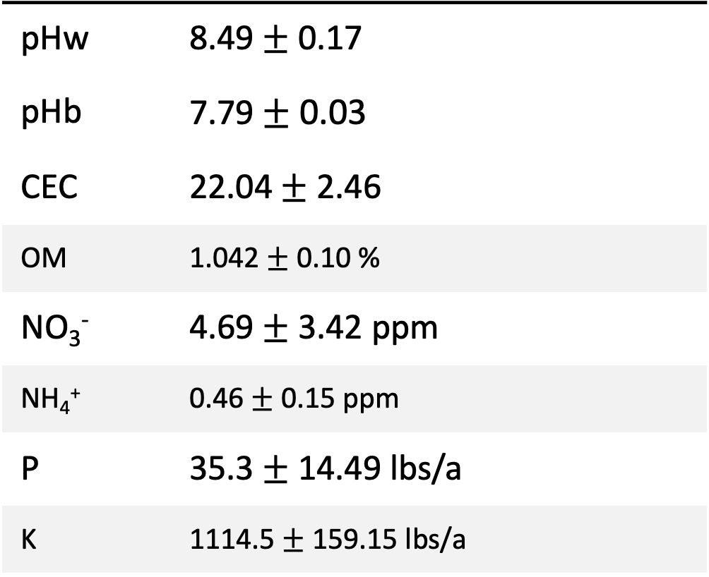
Soil characteristics
pHw | 8.49$±$ 0.17
pHb | 7.79 $±$ 0.03
CEC | 22.04$±$ 2.46
OM | 1.042 $±$ 0.10 %
NO₃⁻ | 4.69 $±$ 3.42 ppm
NH₄⁺ | 0.46 $±$ 0.15 ppm
P | 35.3$±$ 14.49 lbs/a
K | 1114.5 $±$ 159.15 lbs/a

Slide 16
Experimental Design
Plot Size: 7m * 3m
Subplot Size: 1m * 1m
Buffer zone between subplots: 1m

Slide 17
Warming setup

Slide 18
Temperature and moisture measurement

Slide 19
Temperature and moisture measurement

Slide 20
Photosynthesis measurement

Slide 21


Intrinsic Water Use Efficiency ${(WUE}_{i})$
$${WUE}_{i}= \frac{A}{g_{s}}$$
Where A = net assimilation rate and $g_{s}$ = stomatal conductance.
Notes:
c15 data - isotope measurement

Slide 22
Soil Respiration measurement

Slide 23

Yield attributes
Number of bolls per plant
Cotton boll yield
Aboveground and belowground biomass
Harvest Index will be calculated as:
Harvest Index = $\frac{Economic yield}{Total aboveground biomass yield}$

Slide 24
Soil Sample Collection and Laboratory Analysis
Two soil samples will be collected from a subplot after the crop harvest.
Collected soil samples will be analyzed for:
General soil chemical properties and nutrient availability.
MBC – Chloroform fumigation extraction technique
Microbial abundance : FAME analysis

Slide 25
Preliminary results
Soil respiration

Slide 26
Photosynthesis
Notes:
light saturated photosythesis at a constant temp

Slide 27
Transpiration

Slide 28
Stomatal conductance

Slide 29
References
Allison, S. D., & Treseder, K. K. (2008). Warming and drying suppress microbial activity and carbon cycling in boreal forest soils. Global Change Biology, 14(12), 2898–2909.
Oliveira, T. B., Lucas, R. C., Scarcella, A. S. D. A., Contato, A. G., Pasin, T. M., Martinez, C. A., & Polizeli, M. D. L. T. D. M. (2020). Fungal communities differentially respond to warming and drought in tropical grassland soil. Molecular Ecology, 29(8), 1550–1559.
Rui, J., Li, J., Wang, S., An, J., Liu, W.-T., Lin, Q., Yang, Y., He, Z., & Li, X. (2015). Responses of Bacterial Communities to Simulated Climate Changes in Alpine Meadow Soil of the Qinghai-Tibet Plateau. Applied and Environmental Microbiology, 81(17), 6070–6077.
Sheik, C. S., Beasley, W. H., Elshahed, M. S., Zhou, X., Luo, Y., & Krumholz, L. R. (2011). Effect of warming and drought on grassland microbial communities. The ISME Journal, 5(10), 1692–1700.

Slide 30
Thank you!

Slide 31
Add diagram for hypothesis $ research questions
Wed 9-10 licor

